Slide 1


LakeB2B
ENABLING GROWTH

Slide 2




OUR CAPABILITIES
Brand Building
Campaign Management
Content Marketing
Search Marketing
Online Reputation
Database Management
Creative Solutions
Social Media Management
Marketing Automation
Web Development
Resource/
Staffing Outsourcing
Tele Campaign Team

Slide 3






RESULT DRIVEN MARKETING
Establish Global
Presence
Assess Customer
Intent & Insights
Experience Exponential
Growth
Develop and grow globally by targeting the markets in alignment with your business.
In the age of assistance, delivering growth starts with predicting what people want.
Figuring out the channel you’re going to exploit for growth is just as important as figuring out the kind of product you’re going to market.
Deliver Value
Beyond Measure
Double ROI with
Personalized Solutions
Optimize Campaign
Efficiency
Value creation is the foundation of any business and the most significant aspect of Project Management.
Personalization is a crucial practice in marketing today. More than 80% of companies opt for it, and for those who get it right, the outcome can be substantial.
Reach the target audience in right place,at the right time,with the right message.

Slide 4

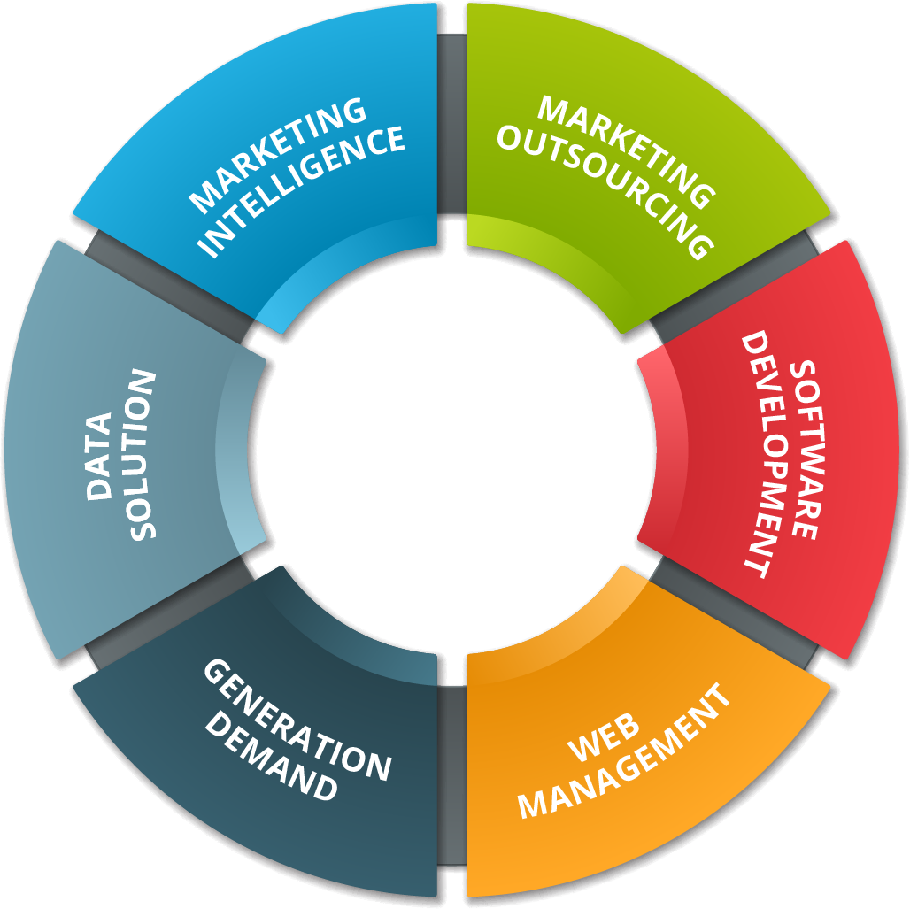




CORE COMPETENCE & INDUSTRY EXPERTISE
Healthcare
Information Technology
Manufacturing
CORE COMPETENCIES
Education
Finance
Other

Slide 5

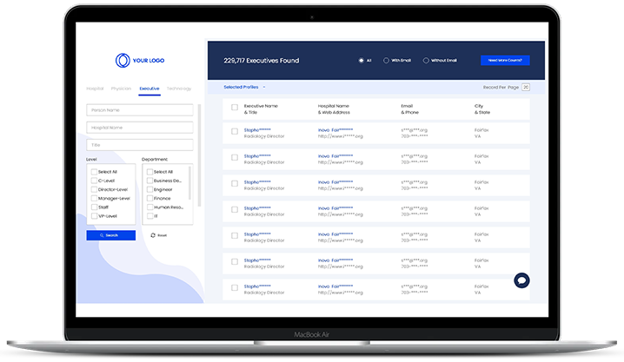
CUSTOMIZED WHITE LABEL SOLUTIONS
Our integrated suite of highly adaptable White Label tools enabled the top technology, physicians, dentists' platforms to get complete customization in terms of branding, marketing, SEO, Email Campaigns. Our white-label solution eliminated the need to spend money and time on R&D, testing, and engineering.
LakeB2B
White Lable Solution Provider
RESELLER
Agency or Saas
Provider
END USER
Business or
Individual
RESELLER will sell solution under their brand or logo
END USER buyes or subscribes to solution from RESELLER
Let consumers find your business instead of your competitors
No investment/licensing permission needed for new technology
Ready-made & customized solutions connected to the partner networks
100% adaptability to future transformation
Ready-to-market platform installation
Guaranteed High Conversion Rates
Continue what you do best & stick to our tailor-made solutions

Slide 6
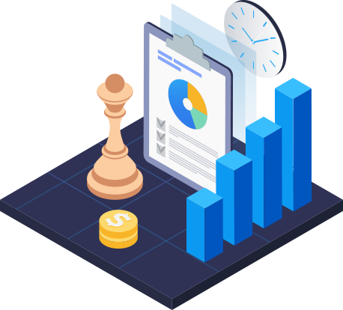



TAM – TOTAL ADDRESSABLE MARKET
Total Addressable Market (TAM) refers to the total market demand for a product or service. The TAM analysis helps to identify the maximum revenue potential of the specific offering across a particular market segment. It helps companies to align & priorities their product & marketing strategy based on the market potential. It is calculated by arriving at the Average revenue per user (ARPU) multiplied by the number of potential customers across a specific market segment. Additionally, when the TAM score is assessed alongside intent data, it helps you identify high value targets based on their purchase traits & behavior patterns.
Here's how it can boost your sales & marketing efficiency to a whole new level
Customer Segmentation
Personalize Communication
Minimize Costs, Optimize Results
Develop a Result-focused Marketing Strategy
Increase Sales Efficiency
Amplify Results with Account - Based Marketing
Assess
Evaluate your Profit Potential
Analyze
Forecast Revenue Goals
Align
Take the Proactive Approach to Success

Slide 7

DATA CAPABILITIES
Total Addressable Market
Social Handles
01
B2B With Direct Dial Contacts
09
02
Investors & Crypto Data
08
03
Technology Install Data
07
04
High Net-worth Data
HealthCare Intelligence Data
06
05
Geo Targeted & Pre-Optimized Data
B2B Custom Data

Slide 8

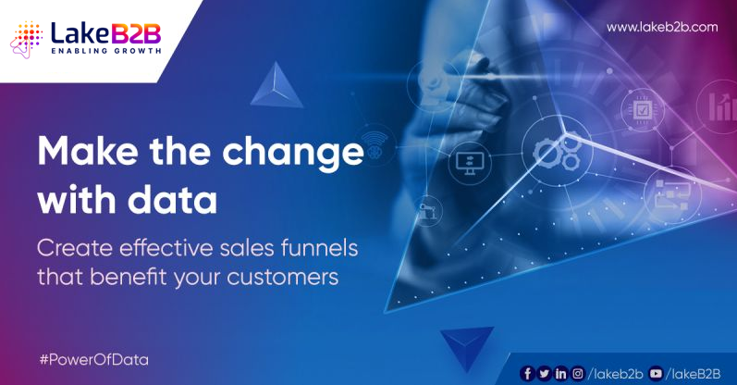
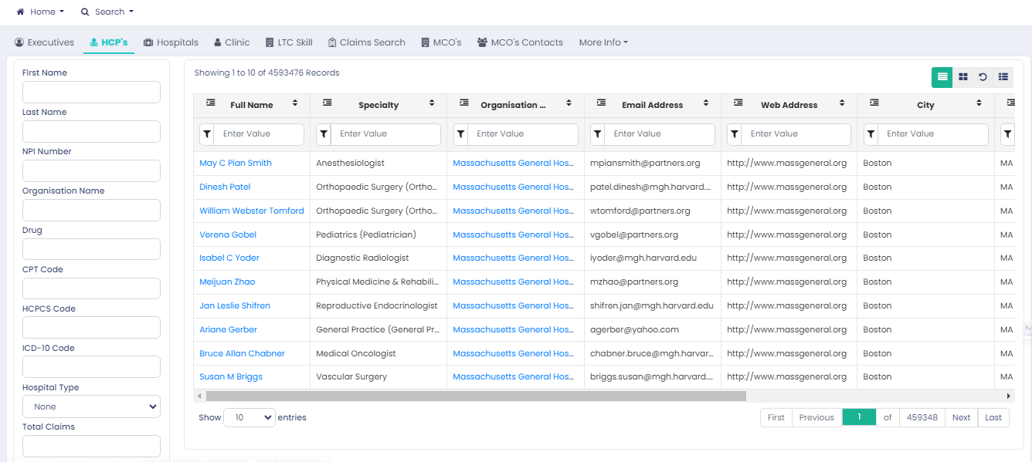


HEALTHCARE DATA CAPABILITIES
Healthcare
Lists
Healthcare Intelligence Platform
Healthcare Appending
& Enrichment
Helps you communicate & engage with top Healthcare Executives from across the globe. Access 26+Millon Healthcare contact data that is multi-source verified to ensure you enjoy multi-channel campaign success.
Acquire millions of professionals’ & practitioners; contacts from top healthcare institutions across the globe
Additional intelligence on:
Top purchased drugs/medications
Spendings of top medical firms
Firmographic details
Highlights on healthcare trends
Update your database with every single detail about customers, both old and new. Our experts gather these data from credible sources to keep the databank fresh and relevant, Data Enrichment Services will help you connect with your global customers and stay ahead of your competitors

Slide 9
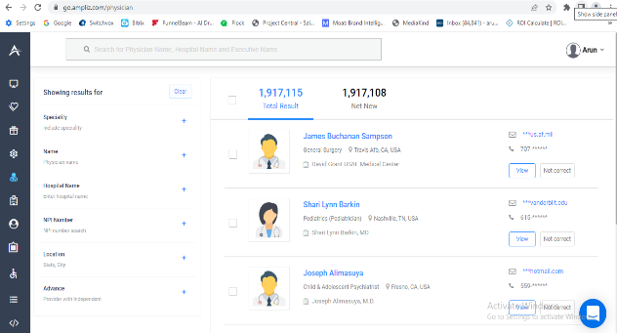


OTHER DATA CAPABILITIES
B2B Custom Data
Technology Insights
Active Audience Targeting
Select your business focus, and get your dataset arranged accordingly, segmented by demographics, regions and industry
Over 85% Accuracy on any list
Matched to business objective(s)
Region and industry segmented
Pre-tested for quick delivery
Organizational hierarchy added
Simple and transparent data processing
Discover ideal target groups from similar business technology installers identified across sectors
We Cover:
12,000+ Technologies
1M+ top global tech firms
Gauge your total active demand with Intent Data
Engage with relevant audience at the right time, on a right channel and a right device.

Slide 10
MARKETING CAPABILITIES
Search Engine Optimization
Tele Marketing
01
Social Media Marketing
09
02
Cross-Channel Marketing
08
03
Content Marketing
07
04
Digital Marketing
Event Management
06
05
Email Marketing
Web & App Development

Slide 11
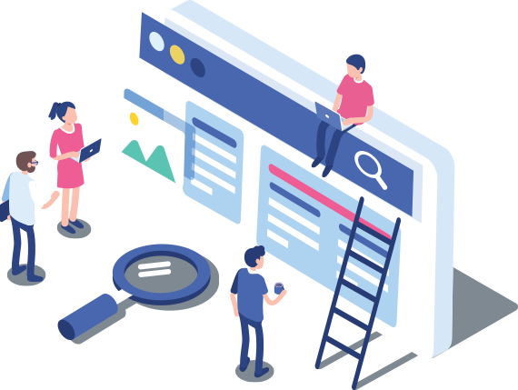

SEARCH ENGINE OPTIMIZATION (SEO)
Successful SEO happens when you have experts implementing Search Optimization to elevate search rankings for every webpage you own. To add value to that, you may want to use an internal CRM application that we provide free to customers. Our own SEO techniques gained a position in the top 5 for “CRM for Small Business” within two months of implementation. To see to it that your SEO capabilities stay in full bloom, we perform website audit, keyword building, appropriate analysis, link building, content, site architecture, and even build for you a landing page to conduct traffic-boosting email marketing.
Improve The Keyword Rankings
Increase The Traffic
Stabilize The Bounce Rate
Web Analytics In Order To Assess Results

Slide 12
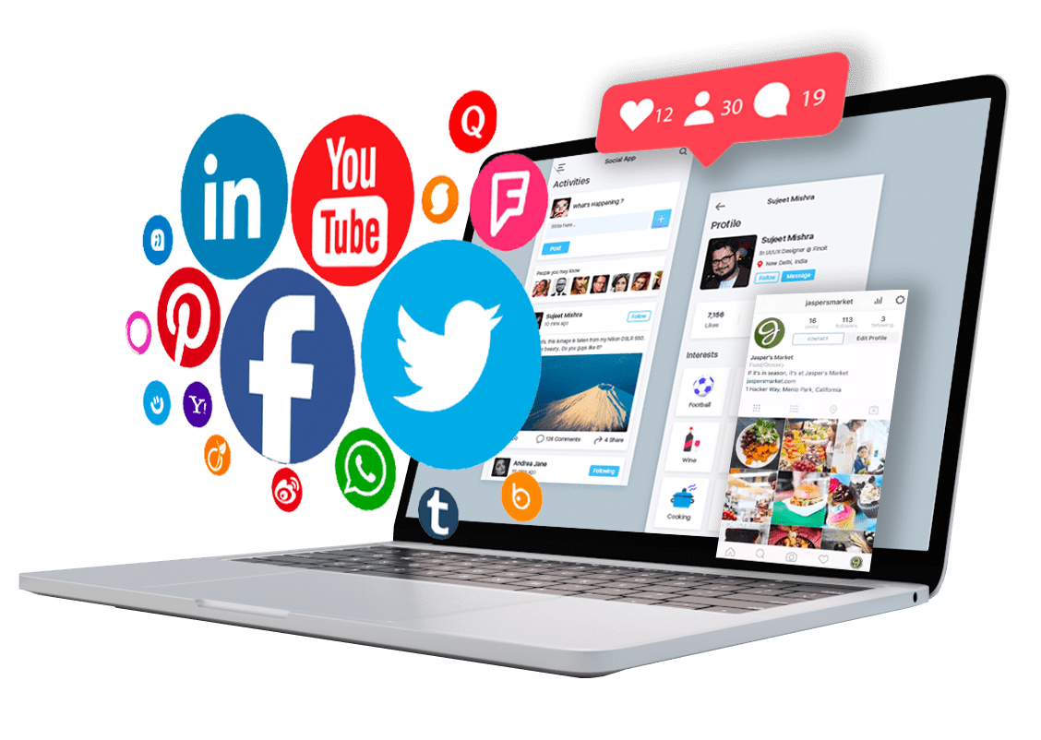
SOCIAL MEDIA MARKETING (SMM)
We enable the prospect participants to have access to your brand, engage them with the most essential information and grow their enthusiasm for what you can do. Thus, they enjoy their experience with your brand and share the same with their peers in their networks.
Position the brand as a thought leader in the industry
Grow social media community via creative story telling
Grow engagement through effective content & paid strategy
Increase traffic to website from Social Channels

Slide 13
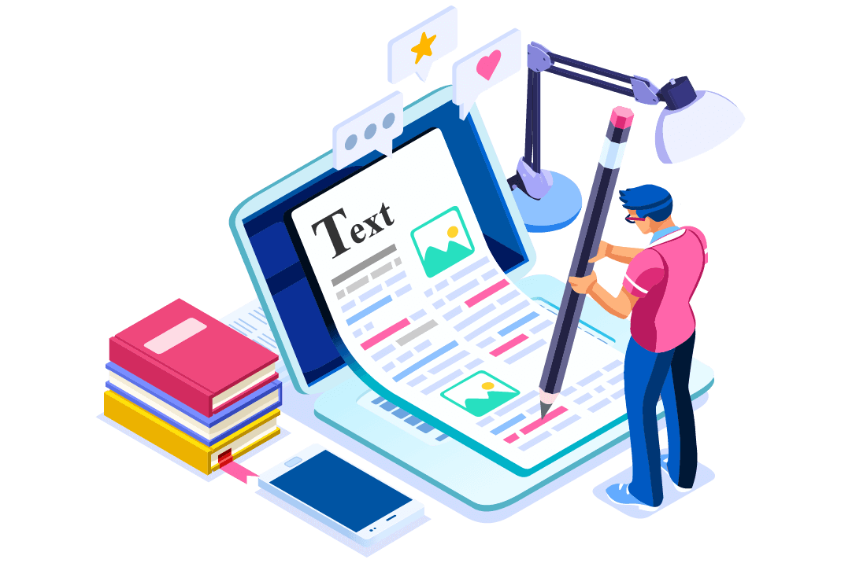
CONTENT MARKETING
Visual storytelling is a content marketing strategy aimed at creating compelling narratives to engage the audience using visual aids. While this content strategy still focuses on educating or informing the customer, it also tries to persuade them to reach a specific conclusion in their buyer’s journey.
Position The Brand As A Thought Leader In The Industry
Increase The Content Consumption Amongst Target Group
Grow Engagement Through Effective Content Syndication
Drive Prospects Across The Funnel
Generate Top & Middle of the funnel leads through gated content

Slide 14
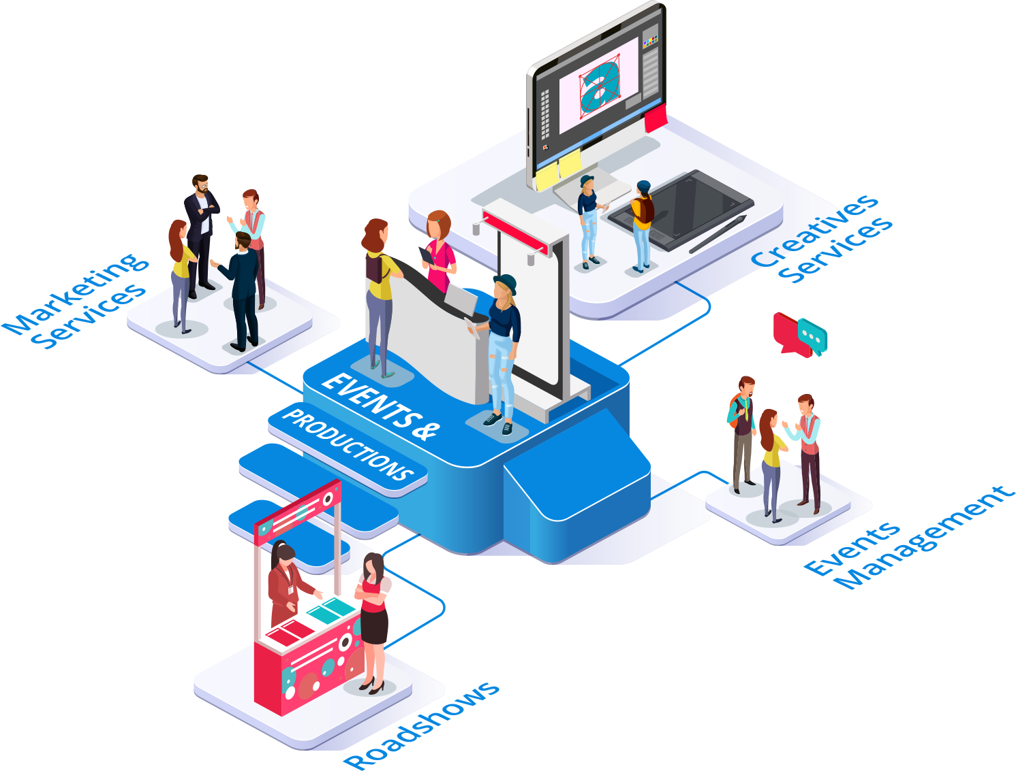
EVENT MARKETING
Event Marketers, when they fail to ramp up their promotional efforts on time, often lose out heavily on their target customers. Keep yourself, your team, and your subscribers on track, with regular email marketing newsletters and updates. Opting for a strategic approach concerning the timing and frequency of your updates is the key here. Do not bug your audience continuously, that too long before the main event. Make every update count and never send it unless the content amplifies their interest level towards the upcoming event. Through this, the audiences will not only be keen towards your brand but will also be eager to respond to your messages.
Effective Planning & Organization.
Enhanced Attendee Experience.
Effective Networking Opportunities.
Brand Visibility & Promotion.

Slide 15
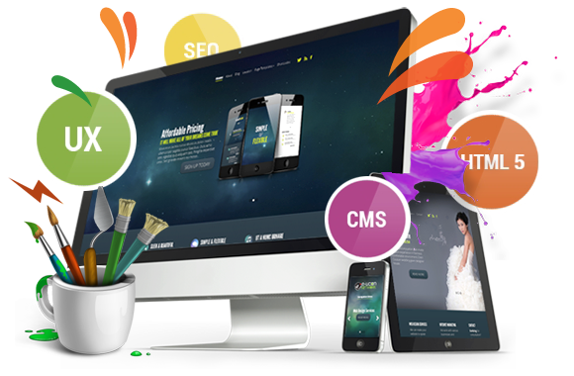
WEBSITE & APPLICATION DEVELOPMENT
Our Web Development Services helps you to create websites which are both visually appealing and interactive. Our full-stack web designers and developers enjoy the decade long expertise. We can compose high-end web solutions, web applications, and web portal development. All are with exquisitely robust user experiences and tailored-made to meet your specific industry needs. Our dedicated web developers have completed 1000+ web projects for industries with diverse business domains. We create best-in-class compelling functionality and deliver the best of both worlds of startup to enterprise fragment.
Increased Online Presence.
Improved User Experience.
Enhanced Functionality & Efficiency.
Accessibility & Reach

Slide 16

EMAIL OUTREACH MARKETING
We roll out customized email marketing campaigns to help your business improve lead generation, conversion, and revenue. Whether you are starting your first email campaign or are an experienced professional. We can certainly provide the perfect platform to aid your campaign requirement.
Email Campaigns.
Survey Campaigns.
Webinar Campaigns.
Lead & Audience Generation.
Research & Market Report Campaigns.

Slide 17
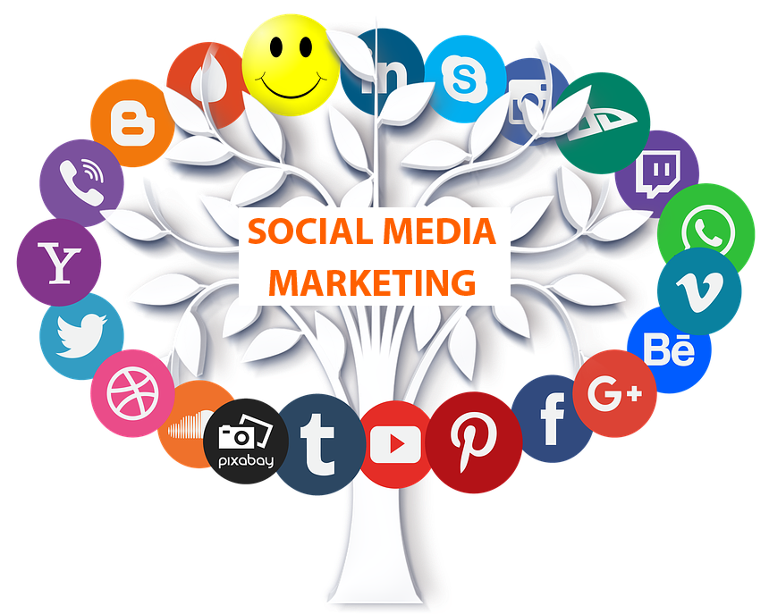
SOCIAL MARKETING CAMPAIGN
The modern-day consumer has access to "collective intelligence" or "hive minds" via social media platforms. As a result, manufacturers are no longer the sole source of information for products or services. In order to avoid losing control over the end-consumer, B2B brands are in dire need for a marketing solution that addresses both the expert market and the consumer market in a parallel path.
LinkedIn Campaigns.
YouTube Campaigns.
Instagram Campaigns.
Twitter Campaigns.
WhatsApp Campaigns.
Google Ads.
Display Ads.
Retargeting & Remarketing.

Slide 18

TELE MARKETING CAMAPAIGNS
Telemarketing is a powerful demand generation tactic and a cost-effective way to generate qualified leads. If utilized strategically, telemarketing can provide high lead generation ROI. In a serious environment of the B2B market, the impact of human conversation and connection can provide highly positive results. After all, companies and brands are owned and managed by people.
Form Fills.
Market Qualified Leads (MQL).
Sales Qualified Leads (SQL).
Webinar & Survey.
Product Branding.
Inside Sales.
Outbound Calling.
(HQL) & (BANT) Leads.

Slide 19



















OUR EXCLUSIVE CLIENTLEE

Slide 20






OUR GLOBAL PRESENCE
USA
9450 Southwest Gemini Drive, 83797 Beaverton, OR 97008
4770 Baseline Road, Suite 200, Boulder, Colorado, 80303
INDIA
St No. 91, 92, Sarjapur – Marathahalli Rd, Carmelaram, Ambedkar Nagar, Chikkabellandur, Bengaluru, Karnataka 560035
UK
27 Old Gloucester Street London, WC1N 3AX
DUBAI
Level 29, Marina Plaza, Dubai Marina, Dubai, UAE
SINGAPORE
Level 39, Marina Bay, Financial Center Tower 2, 10 Marina Boulevard, Singapore-018983
JAPAN
Level 11, Aoyama Palacio Tower 3-6-7 Kita-Aoyama, Minato-ku, Tokyo 107-0061

